Slide 1
Fake News Classifier
BT4222 Final Project
Group 7
Fake!
Real!
Ang Jamais - A0188978W
Erica Jane Tem - A0189505W
Jay Lew Jie Sheng - A0183426A
Justin Julius Chu Qijie - A0183794M
Lim Joo Bin - A0182574X
Notes:
Hello, good afternoon everyone. I am Jay and together with me are my group mates, Jamais, Erica, Justin and Joo Bin.
Today, we are going to be presenting on our classification system which aims to classify fake and satire news.

Slide 2
TABLE OF CONTENTS
Introduction
01
02
Gradient Boosting
Neural Network Models
03
04
Results & Evaluation
Application & Conclusion
05
Exploratory Analysis
Data Pre-processing
Baseline Models
ANN
CNN
RNN
BERT
Notes:
As such, we will be sharing about our motivation for this project, some of the non-neural network and neural network models we have deployed, our results from these models, our thoughts about the results, and finally how our model can be further improved and applied to other datasets.

Slide 3
01
Introduction
Notes:
So, what was our motivation behind this project?

Slide 4
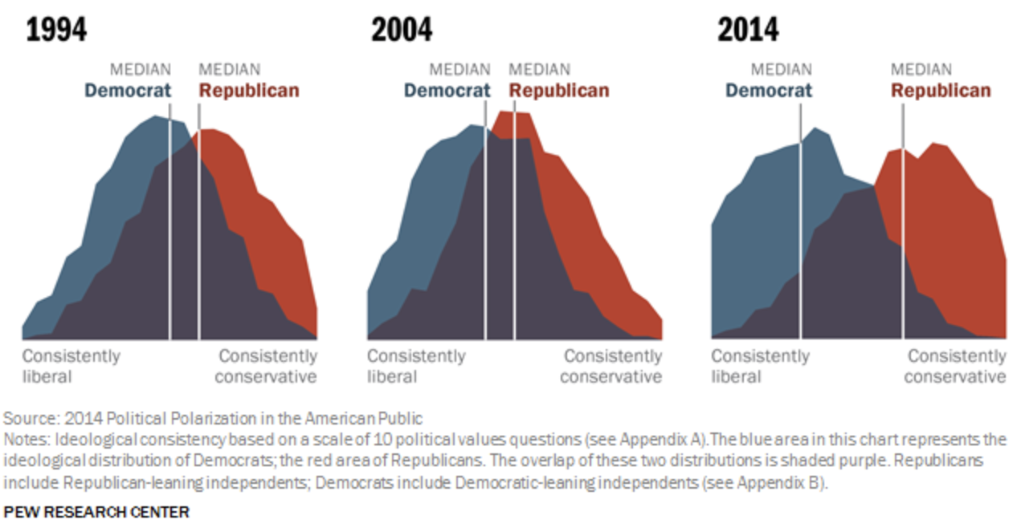
Problem
Description
Spread of fake news has been getting rampant in recent years.
Some fake news can have detrimental effects.
Finding the best model to try and mitigate this problem:
Fake News Classifier
Notes:
Did you know that the prevalence of harmful fake news in the United States has brought about an all-time high in its political divide between the Democrats and the Republicans?
This means that social tensions in the US is at its highest and part of this is a result of the rampant spread of fake news, aided by the rise of social media and technology advancements.
With that, our group felt that there is a need to address and mitigate this issue, to equip people with the tools needed to differentiate satire or fake news from real ones.
Therefore, we have come up with a Fake News Classifier that will be able to distinguish fake news from real ones using only their headlines.

Slide 5



Dataset
Reddit
r/TheOnion
r/NotTheOnion
A subreddit on Reddit that publishes satire news from their website, The Onion.
A subreddit on Reddit that colates factual news that sound satire from various mainstream media outlets.
Notes:
For our dataset, we have decided to turn to Reddit, a web forum site that is categorised into many different groups and categories known as subreddits. In our project, we will be using data specifically from The Onion subreddit and Not The Onion subreddit.
The Onion subreddit allows subscribers to upload satire articles that are only published on The Onion website. The Onion is a popular news site that writes satire news on various issues.
On the other hand, while there is no news site for Not The Onion, the Not The Onion subreddit colates factual news that sound satire from various media outlets.

Slide 6
Exploratory Analysis
News Source(s) | Single | Multiple
Subscriber Count | 156,315 | 18,178,288
Number of Posts (in same time frame) | 9,978 | 13,100
Number of Posts (after duplicates removal) | 8,264 | 8,202
Notes:
With that, because of its single news source and smaller subscriber count, The Onion subreddit has a smaller number of posts at around nine thousand nine hundred in the same time frame as compared to that of Not The Onion, which has about thirteen thousand posts.
However, after the removal of duplicate titles from both subreddits, the number of posts have become more equal between the two, with about eight thousand two hundred posts each.

Slide 7


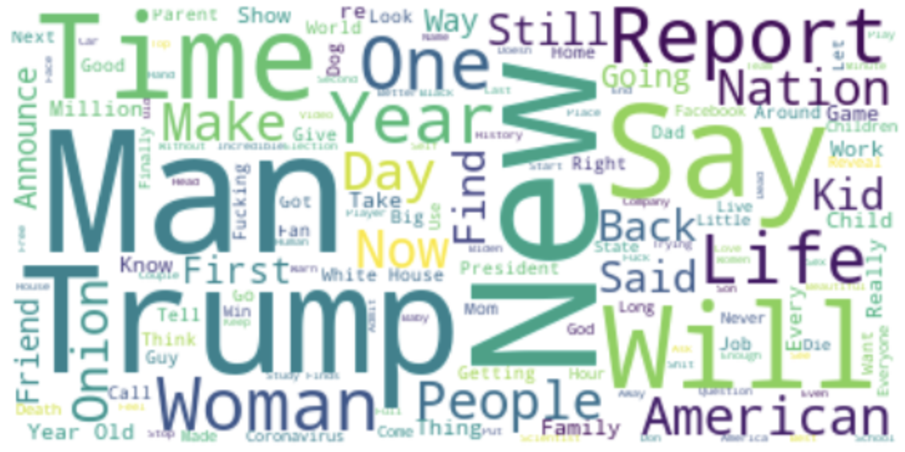
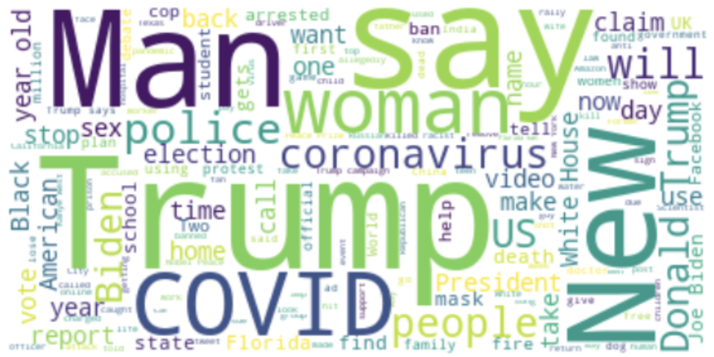
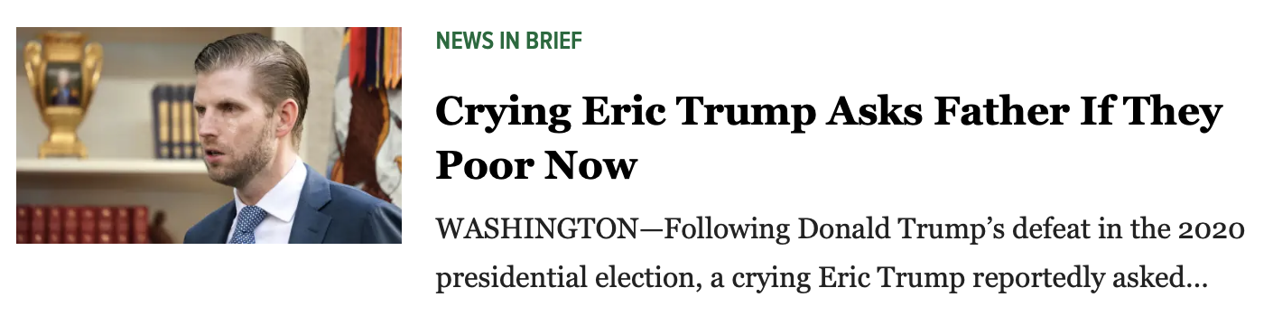
Exploratory Analysis
~ Word Cloud
Similar results from both subreddits
Most common words being
Man
Trump
New
Say
r/TheOnion
r/NotTheOnion
From The Onion
Notes:
We have also generated a word cloud for each subreddit to find out the most common words used in the title for each of the subreddit.
Turns out that both word clouds have very similar results, and the most common words being “Man”, “Trump”, “New” and “Say”.
This makes sense because The Onion tends to write satire articles based on current affairs, whereas news from Not The Onion are also current affairs. As such, both subreddits will tend to use similar words but in different contexts.

Slide 8
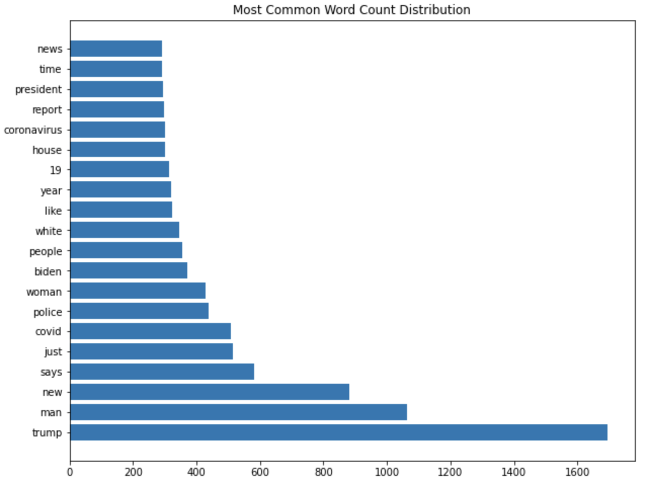
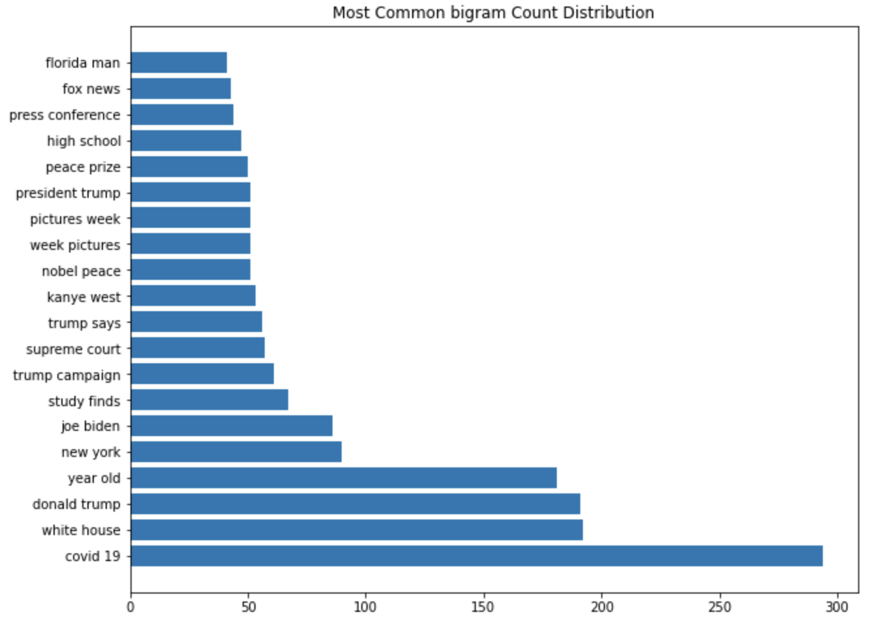
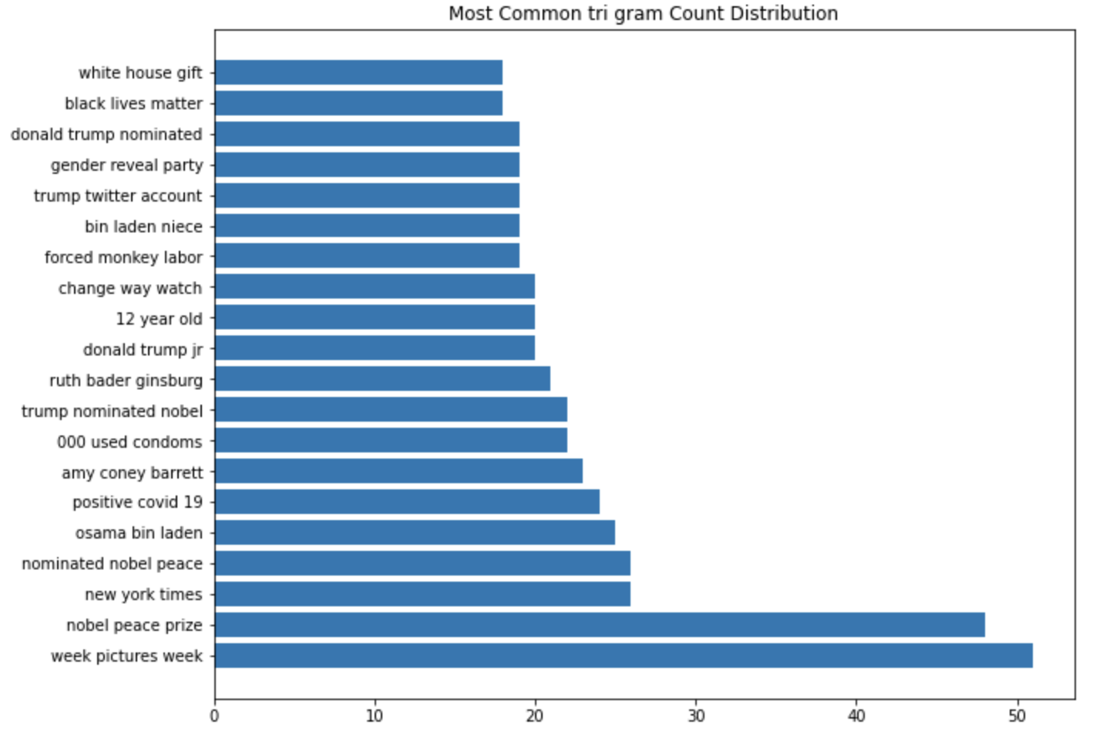
Exploratory Analysis
~ Word, Bigram, Trigram Distribution
Word
Bigram
Trigram
The most common words, bigrams and trigrams are related to current affairs like the 2020 US Presidential Elections and also COVID-19.
Notes:
The distribution of words, bigrams and trigrams are also plotted out.
Given the time frame of our data set, the most common word, bigram and trigram makes sense as the more recent popular topics are the 2020 US Presidential Elections and also Covid-19. The words, bigrams and trigrams used are reflective of that.

Slide 9
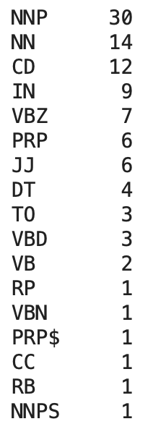
Exploratory Analysis
~ Part-of-Speech Tagging Distribution
As we can see, Proper Nouns and Nouns are very popular in news headlines, as this helps to draw reader’s attention.
Notes:
We also decided to check out the Part-of-speech tagging distribution.
The most common part of speech used are the proper nouns and nouns. This again makes sense because news articles tend to appeal to the masses by having names of well-known people and or places, to increase their readership.

Slide 10
Data Pre-processing
Lemmatization
Standardization
Sampling
Removal of accents, punctuations & stop words
Conversion to lowercase
Conversion of words to base form
Shuffle
Train Test Split
To increase data size
Notes:
Before we dive into our different models, we have to pre-process our data.
The data pre-processing step is carried out in three different phases.
Firstly, would be the standardization of the data by removing fields like accents, punctuations, stop words, and also conversion to lowercase.
Secondly, lemmatization is carried out to convert words into their base form. We chose lemmatization over stemming because lemmatization brings context to the words.
Finally would be the sampling, in which we will be shuffling the data and also performing a random train test split to increase the data size.

Slide 11


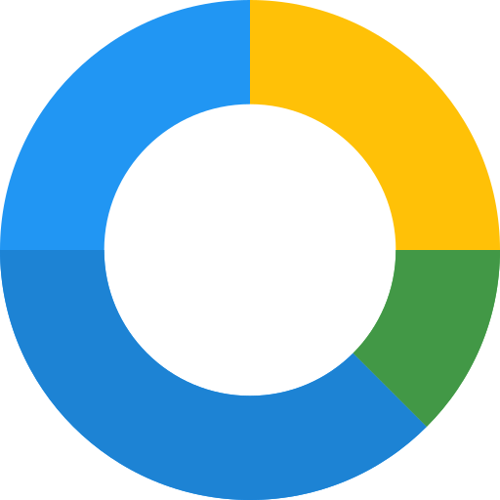
Baseline Models
Random Forest
Logistic Regression
Naive
Bayes
Testing Accuracy:
0.770
Testing Accuracy:
0.797
Testing Accuracy:
0.801
Notes:
Next, we also ran the random forest, logistic regression, and naive bayes models as baseline models to obtain some baseline testing accuracy for our own models that we will be presenting next. This is to have a general sensing of how our models should fare in terms of testing accuracy, and as such our models should aim to be better than these testing accuracies shown.
With that, I will now hand over the time to Justin, who will be talking about some of the models that we have used in this project.

Slide 12
02
Gradient Boosting

Slide 13
Gradient Boosting
What is it?
Parameters Tuned
Boosting method-based ML model
Iteratively learns from weak learners to build strong model through ensembling
Maximum Depth
Learning Rate
Number of Estimator

Slide 14

Neural Network
Models
03

Slide 15
Artificial Neural Network (ANN)
What is it?
Basic form of neural networks
Feedforward network
Serves as a benchmark for the other neural network models
Input
Dense
Dense
Dropout
Dense
Dropout
Dropout
Output

Slide 16
Convolutional Neural Network (CNN)
Input
Embedding
Conv1D
MaxPooling1D
What is it?
Flatten
Dense
Dropout
Output
Widely used in image classification
Can be used for text analysis as well due to its ability to detect specific patterns

Slide 17
Recurrent Neural Network
(RNN)
What is it?
LSTM
Bidirectional LSTM
Share parameters across different time steps
Performs same function for each input of data while output dependent on computation of the previous one
Input
Emb-
edding
LSTM
Dense
Input
Dropout
Dropout
Output
Output
Input
Emb-
edding
Dropout
Dense
Emb-
edding
Bidirec-tional
Bidirec-tional
Bidirec-tional
Dropout
Dense
Dropout
Dropout
Output

Slide 18
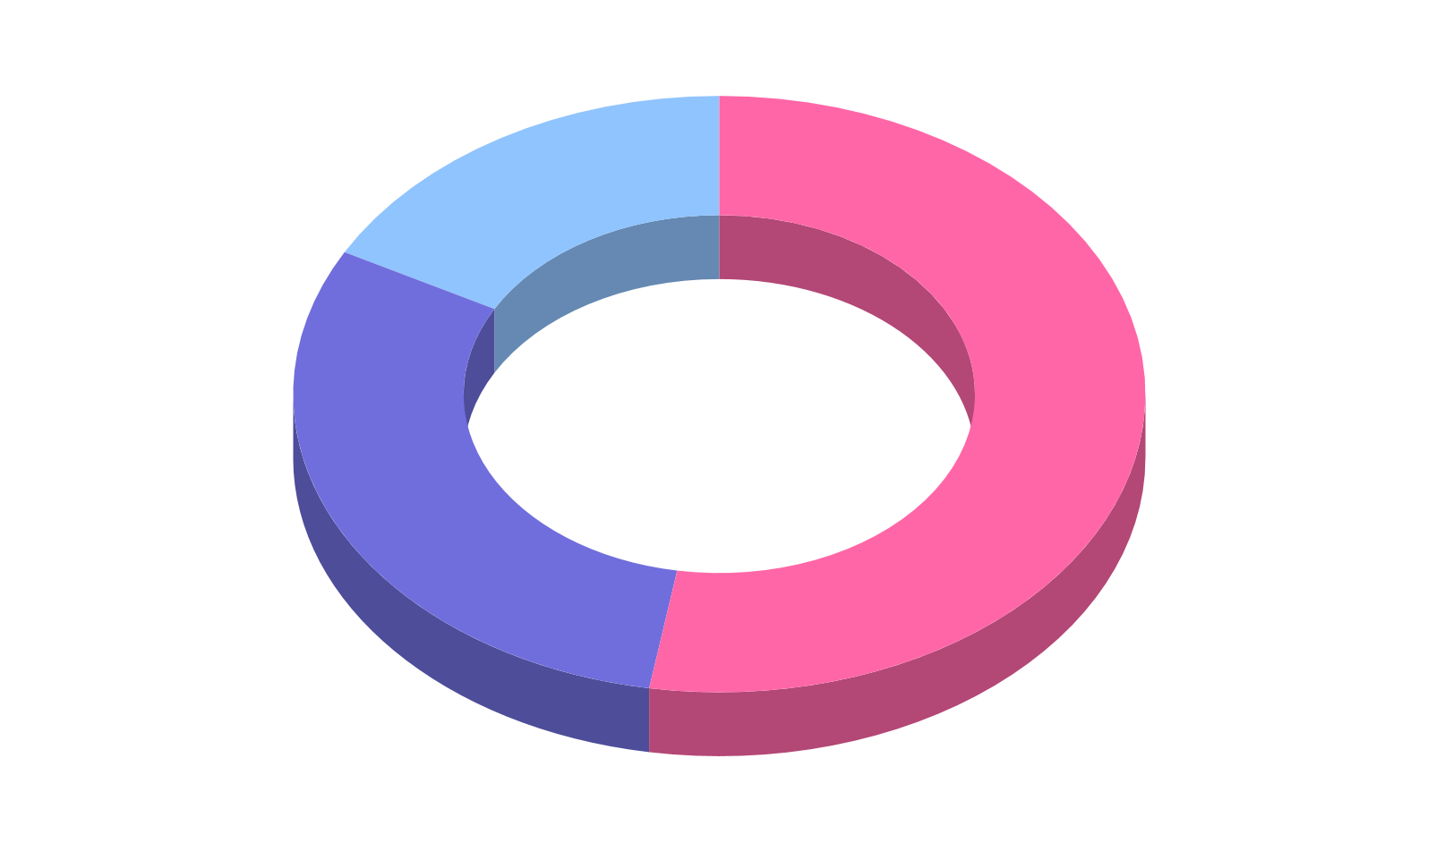
Bidirectional Encoder Representations from Transformers (BERT)
What is it?
Parameters Tuned
NLP framework by Google
Made to learn from words in all positions in the sentence
Differentiate words better based on context
Transfer learning using pre-trained DistilBERT Model
Learning rate
Number of epochs

Slide 19
Results
&
Evaluation
04

Slide 20
OUR
RESULTS
 | ACCURACY | F1-SCORE | PRECISION | RECALL
GRADIENT BOOSTING | 0.685 | 0.690 | 0.67 | 0.70
ANN | 0.838 | 0.839 | 0.839 | 0.839
CNN | 0.827 | 0.828 | 0.828 | 0.827
RNN (LSTM) | 0.780 | 0.780 | 0.780 | 0.780
RNN (Bidirectional LSTM) | 0.807 | 0.802 | 0.822 | 0.792
BERT | 0.905 | 0.913 | 0.892 | 0.935

Slide 21
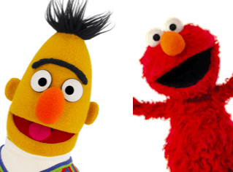
Model Evaluation
The use of pre-trained models
Context-heavy classification using other frameworks

Slide 22
Application
&
Conclusion
05
Notes:
Thank you erica. Now we will move on to discuss some applications for our model as well as our reflections on our project.

Slide 23
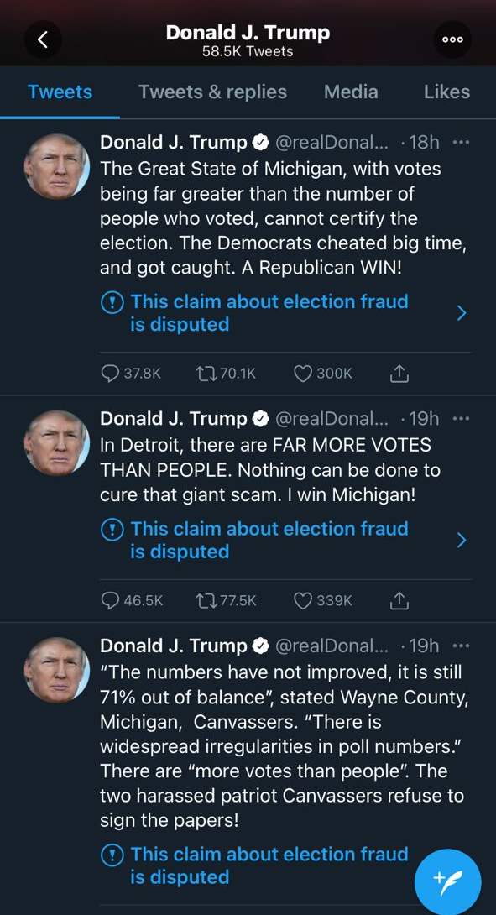


Slide 24
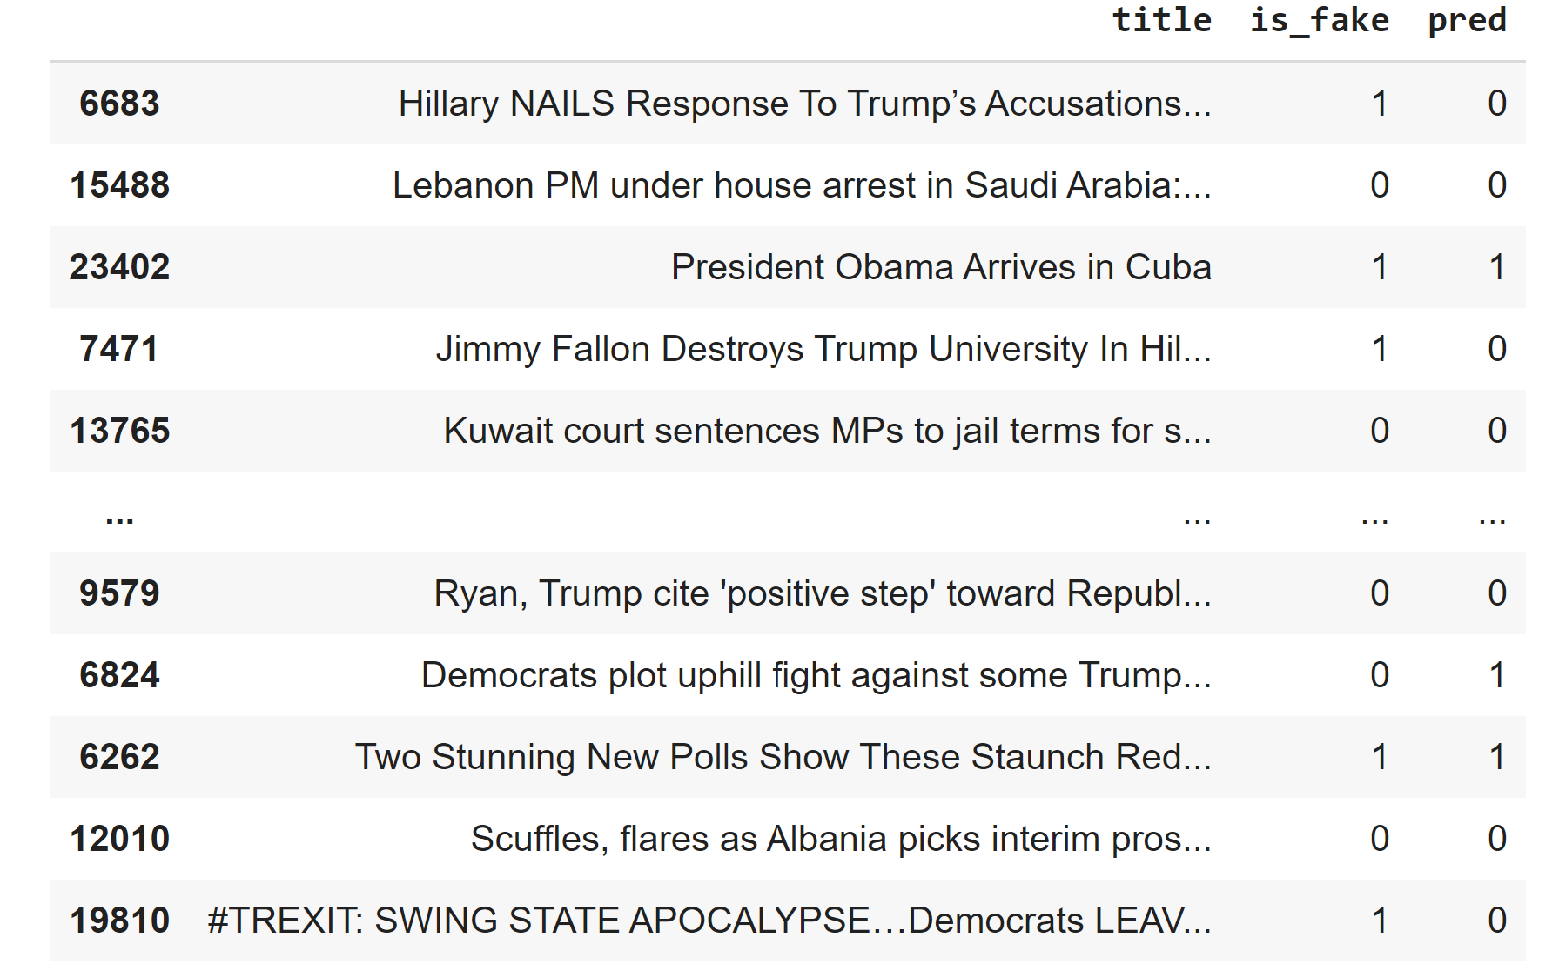
Data Insights

Slide 25
INSIGHTS & IMPROVEMENTS
FINDING 1:
FINDING 2:
Expanding to analyse the whole article
Analyzing the context of the author

Slide 26
INSIGHTS AND IMPROVEMENTS
FINDING
03
FINDING
04
Using a more global dataset - source and time frame of data
Using more extensive language data sets with various tones and styles

Slide 27
THANK
YOU
Please keep this slide for attribution.
Notes:
With that we have come to the end of our presentation. We hope you have enjoyed our presentation and have learnt a little bit more about our project! Thank you

